Slide 1
CONTACT TRACING AND TIME TO TARGET
The following slide illustrates a sequence of increasingly restrictive policy goals influences the range of options available to respond to the COVID-19 epidemic
The graphs show model simulation results for combinations of:
i) R value from 0.5 to 1 (vertical axis)
ii) Target incidence: 1, 10 or 100 new cases per day (vertical blocks)
iii) Rate at which contact tracing coverage can be ramped up (horizontal axis)
iv) Effectiveness of contact tracing (relative to 100% coverage)
Colour coding indicates the time period during which target incidence would be achieved.
These scenarios assume a starting incidence (at 25/05/20) of 850 new cases per day; this is consistent with ONS estimates but could be a factor of 2 higher or lower.
Caveat: These are scenario models. They are calibrated to be consistent with the epidemic data so far but they are not predictions. Full details of the modelling are available on request.
Epigroup, University of Edinburgh, 28/05/20

Slide 2
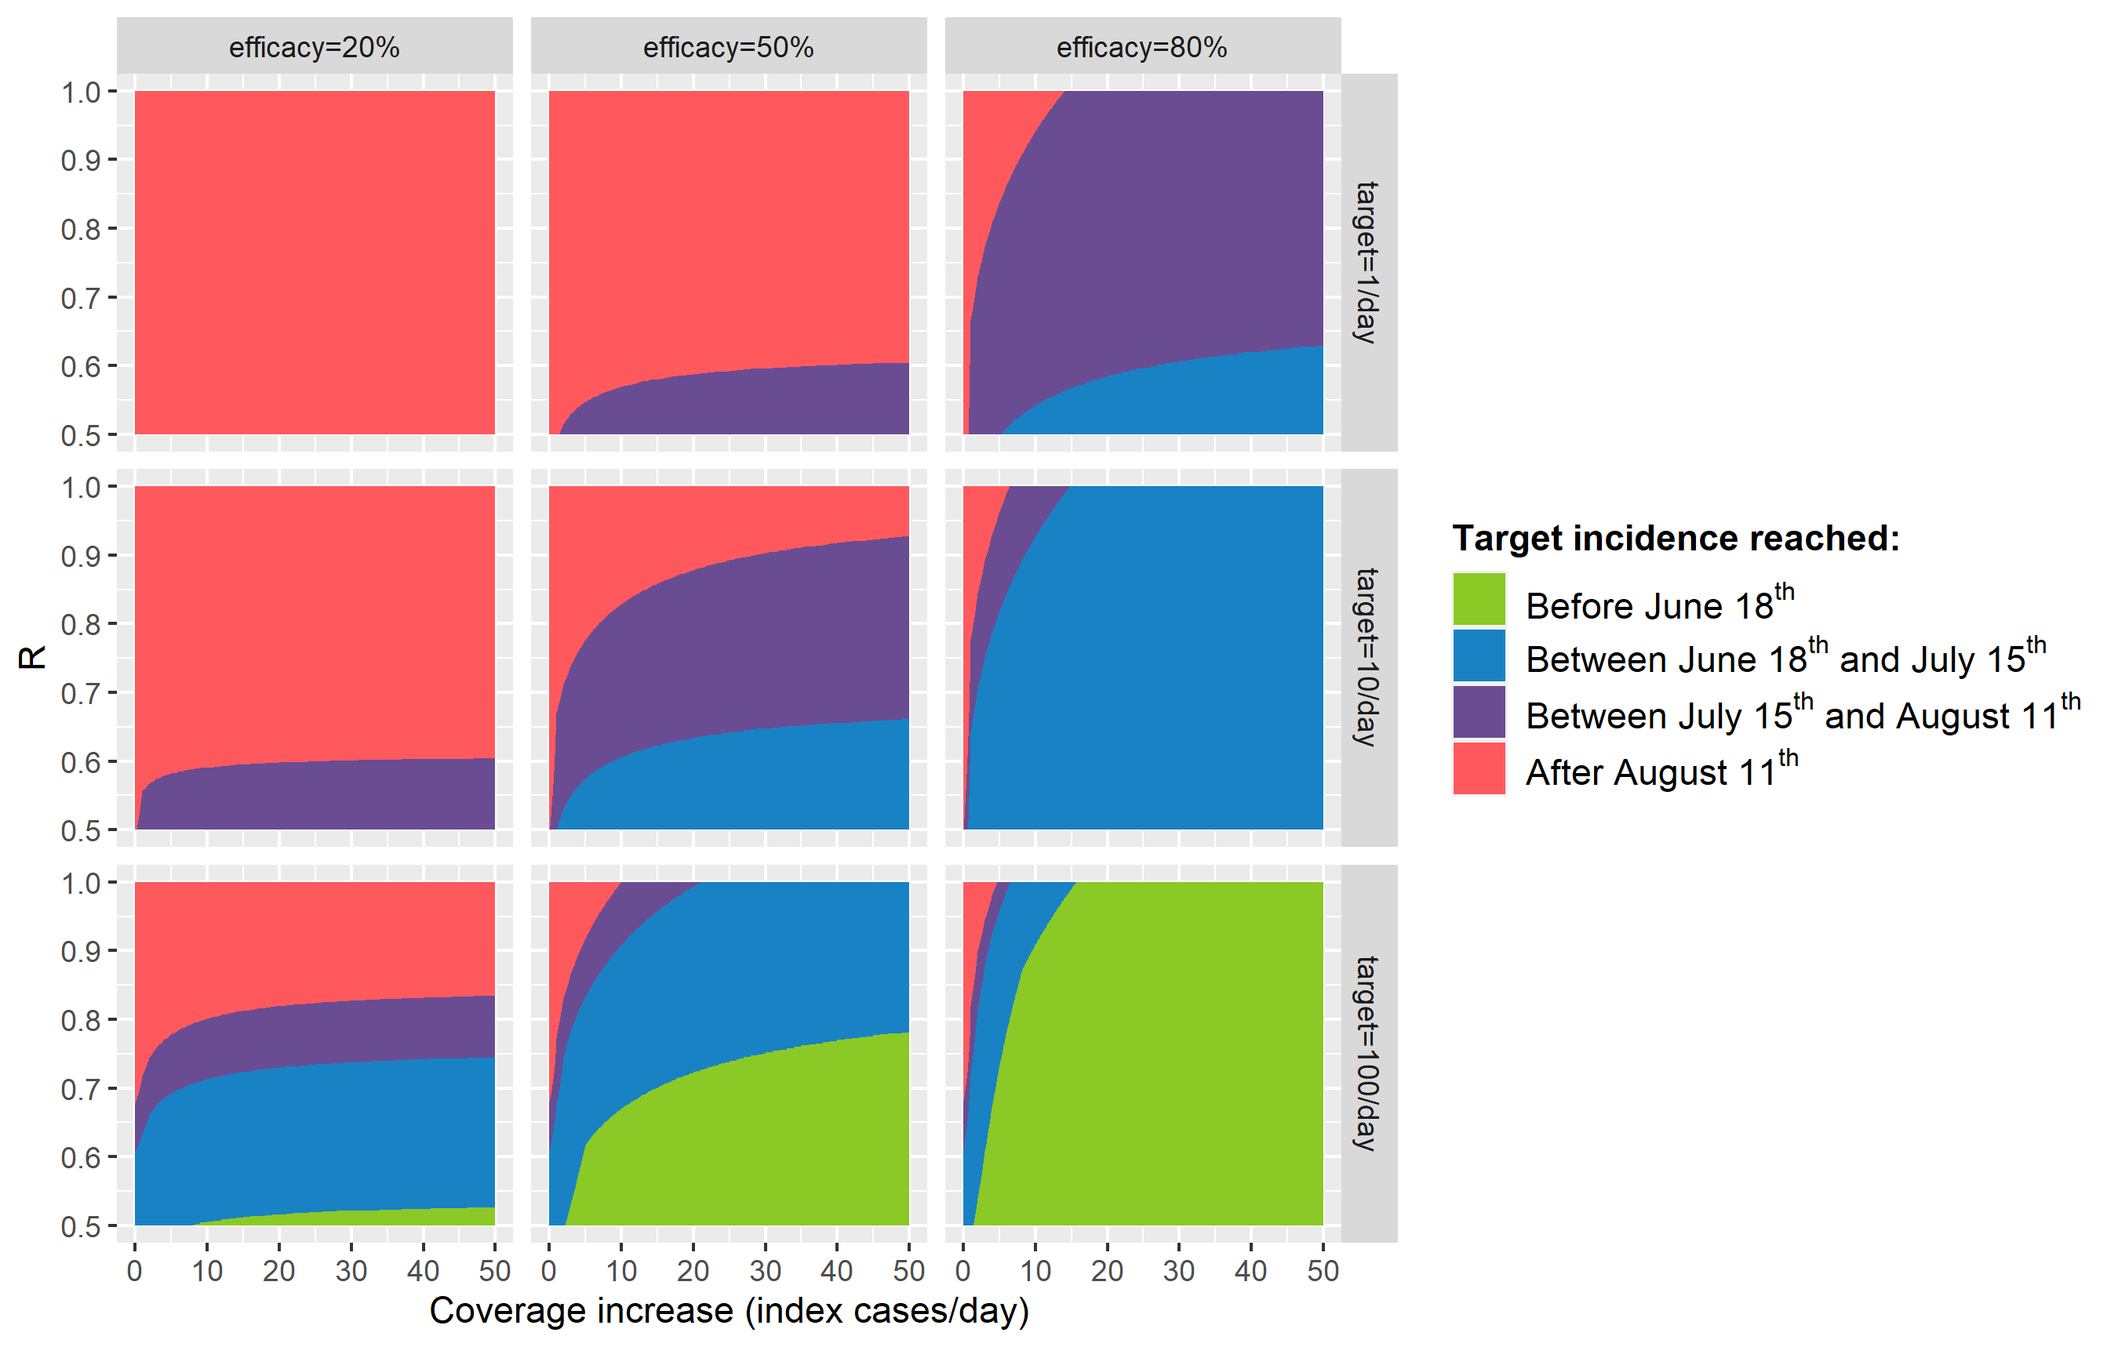
KEY RESULTS
Time to target depends on what the target is
Near eradication very hard to achieve quickly unless efficacy is very high
At current R≈0.85 much less prospect of reaching target quickly (cf. R≈0.50)
If effectiveness is <50% then much less prospect of reaching target quickly (cf. effectiveness >80%)
Rate of increase of coverage shows diminishing returns
Epigroup, University of Edinburgh, 28/05/20

